Slide 1
CYCLIC CODES
EE 430 \ Dr. Muqaibel
Cyclic Codes <number>

Slide 2
Motivation & Properties of cyclic code
Cyclic code are a class of linear block codes. Thus, we can find generator matrix (G) and parity check matrix (H).
The reason is that they can be easily implemented with externally cost effective electronic circuit.

Slide 3
Definition
An (n,k) linear code C is cyclic if every cyclic shift of a codeword in C is also a codeword in C.
  If c₀ c₁ c₂ …. c_{n-2} c_{n-1} is a codeword, then
  c_{n-1} c₀ c₁ …. c_{n-3} c_{n-2}
  c_{n-2} c_{n-1} c₀ …. c_{n-4} c_{n-3}
  : : : : :
  c₁ c₂ c₃ …. c_{n-1} c₀ are all codewords.
EE 430 \ Dr. Muqaibel
Cyclic Codes <number>

Slide 4
Example: (6,2) repetition code
is a cyclic code.

Slide 5
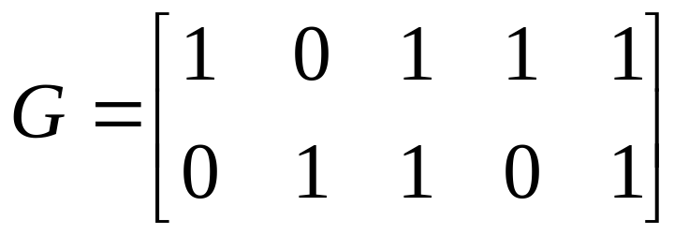
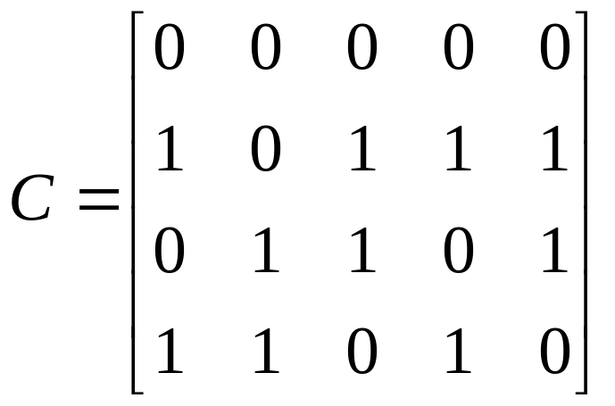

Example2: (5,2) linear block code
is a single error correcting code, the set of codeword are:
Thus, it is not a cyclic code since, for example, the cyclic shift of [10111] is [11011]

Slide 6
Example 3
The (7,4) Hamming code discussed before is cyclic:
  1010001 1110010 0000000 1111111
  1101000 0111001
  0110100 1011100
  0011010 0101110
  0001101 0010111
  1000110 1001011
  0100011 1100101
EE 430 \ Dr. Muqaibel
Cyclic Codes <number>

Slide 7
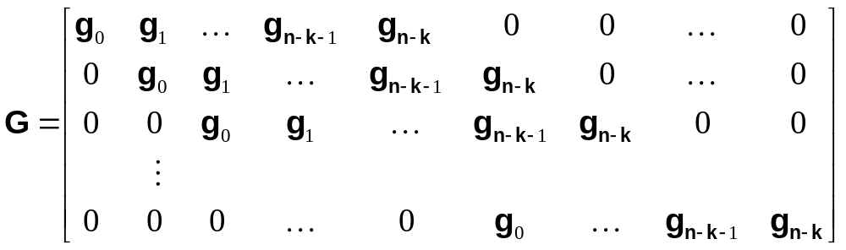

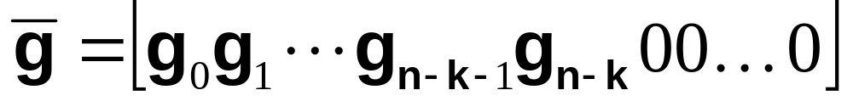
Generator matrix of a non-systematic (n,k) cyclic codes
The generator matrix will be in this form:
notice that the row are merely cyclic shifts of the
basis vector

Slide 8

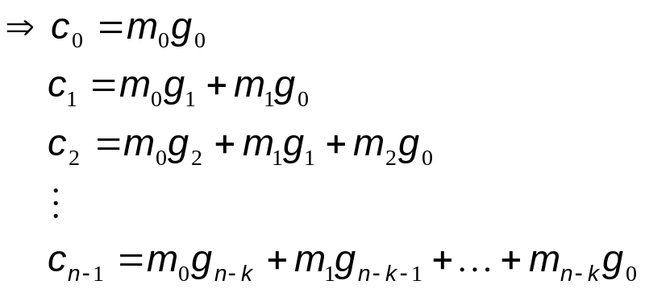
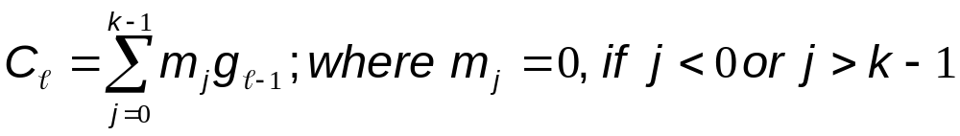
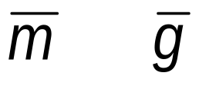
The code vector are:
Notice that,
This summation is a convolution between and .
It would be much easier if we deal with multiplication, this transform is done using Polynomial Representation.

Slide 9

Code Polynomial
Let c = c₀ c₁ c₂ …. c_{n-1}. The code polynomial of c: c(X) = c₀ + c₁X+ c₂ X² + …. + c_{n-1} X^{n-1}
  where the power of X corresponds to the bit position, and
  the coefficients are 0’s and 1’s.
Example:
  1010001 1+X²+X⁶
  0101110 X+X³+X⁴+X⁵
  Each codeword is represented by a polynomial of degree
  less than or equal n-1.
EE 430 \ Dr. Muqaibel
Cyclic Codes <number>

Slide 10
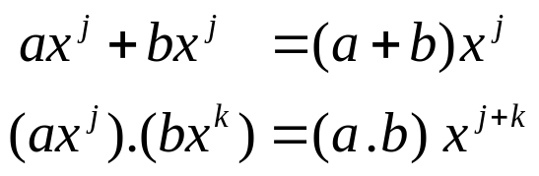
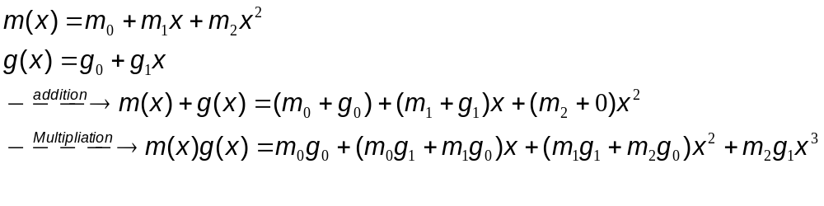
The addition and multiplication are as follow:
Where (a+b) and (a.b) are under GF(2). But j+k is integral addition
Example:
Notice that in multiplication the coefficient are the same as convolution sum

Slide 11
Implementing the Shift
Let c = c₀ c₁ c₂ …. c_{n-1}
and c^{(i)} = c_{n-i} c_{n-i+1} c₀ …. c_{n-i-1} (i shifts to the right)
c(X) = c₀ + c₁X+ c₂ X² + …. + c_{n-1} X^{n-1}
c ^{(i)}(X) = c_{n-i} + c_{n-i+1} X + …. + c_{n-1} X^{i-1} + …. +
c₀X^{i} +…. +c_{n-i-1} X^{n-1}
What is the relation between c(X) and c ^{(i)}(X)?
Apparently, shifting a bit one place to the right is equivalent
to multiplying the term by X.
X^{i}c(X)= c₀X^{i} +c₁X ^{i+1} + ….+ c_{n-i-1} X^{n-1} + c_{n-i} X^{n} ….+ c_{n-1} X^{n+i-1}
EE 430 \ Dr. Muqaibel
Cyclic Codes <number>

Slide 12

Implementing the Shift (cont’d)
X^{i}c(X) = c_{n-i} X^{n} +…+c_{n-1} X^{n+i-1} +c₀X^{i} +c₁X ^{i+1} + …+ c_{n-i-1} X^{n-1}
The first i terms have powers n, and are not suitable for
representing bit locations.
Add to the polynomial the zero-valued sequence:
(c_{n-i} + c_{n-i} ) + (c_{n-i+1} + c_{n-i+1} )X + …. + (c_{n-1} + c_{n-1} )X^{i-1}
X^{i}c(X) = c_{n-i} (X^{n} +1) + c_{n-i+1} X (X^{n} +1)+…. +c_{n-1} X^{i-1} (X^{n} +1)+ c_{n-i} + c_{n-i+1} X +…. +c_{n-1} X^{i-1}+
c₀X^{i} +c₁X ^{i+1} + …. + c_{n-i-1} X^{n-1}
That is:
X^{i}c(X) = q(X)(X^{n} +1) + c^{(i)}(X)
EE 430 \ Dr. Muqaibel
Cyclic Codes <number>

Slide 13
Implementing the Shift (cont’d)
c^{(i)}(X) is the remainder from dividing X^{i}c(X) by (X^{n} +1).
c^{(i)}(X) = Rem[X^{i}c(X)/ (X^{n} +1)] = X^{i}c(X) mod (X^{n} +1).
Example:
c = 0101110. c(X) = X + X³ + X⁴ + X⁵.
X³c(X) = X⁴ + X⁶ + X⁷ + X⁸
Rem[X³c(X)/ (X⁷ +1)] = 1 + X + X⁴ + X⁶ [Show]
c⁽³⁾ = 1100101
Short cut of long division:
X^{i}c(X)|_{X}^{n}₌₁ = q(X)(X^{n} +1) |_{X}^{n}₌₁ + c^{(i)}(X) |_{X}^{n}₌₁
That is c^{(i)}(X) = X^{i}c(X)|_{X}^{n}₌₁
EE 430 \ Dr. Muqaibel
Cyclic Codes <number>

Slide 14
More on Code Polynomials
The nonzero code polynomial of minimum degree in a cyclic code C is unique.
  (If not, the sum of the two polynomials will be a code polynomial of degree less than the minimum. Contradiction)
Let g(X) = g₀ + g₁X +….+ g_{r-1}X^{r-1} +X^{r} be the nonzero code polynomial of minimum degree in an (n,k) cyclic code. Then the constant term g₀ must be equal to 1.
  (If not, then one cyclic shift to the left will produce a code polynomial of degree less than the minimum. Contradiction)
For the (7,4) code given in the Table, the nonzero code polynomial of minimum degree is g(X) = 1 + X + X³
EE 430 \ Dr. Muqaibel
Cyclic Codes <number>

Slide 15
Generator Polynomial
Since the code is cyclic: Xg(X), X²g(X),…., X^{n-r-1}g(X) are code polynomials in C. (Note that deg[X^{n-r-1}g(X)] = n-1).
Since the code is linear:
  (a₀ + a₁X + …. + a_{n-r-1} X^{n-r-1})g(X) is also a code
  polynomial, where a_{i} = 0 or 1.
A binary polynomial of degree n-1 or less is a code polynomial if and only if it is a multiple of g(X).
  (First part shown. Second part: if a code polynomial c(X) is not a
  multiple of g(X), then Rem[c(X)/g(X)] must be a code polynomial of
  degree less than the minimum. Contradiction)
EE 430 \ Dr. Muqaibel
Cyclic Codes <number>

Slide 16

Generator Polynomial (cont’d)
All code polynomials are generated from the multiplication c(X) = a(X)g(X).
  deg[c(x)] n-1, deg[g(X)] = r, ==> deg[a(x)] n-r-1
  # codewords, (2^{k}) = # different ways of forming a(x), 2^{n-r}
  Therefore, r = deg[g(X)] = n-k
Since deg[a(X)] k-1, the polynomial a(X) may be taken to be the information polynomial u(X) (a polynomial whose coefficients are the information bits). Encoding is performed by the multiplication c(X) = u(X)g(X).
g(X), generator polynomial, completely defines the code.
EE 430 \ Dr. Muqaibel
Cyclic Codes <number>

Slide 17
(7,4) Code Generated by 1+X+X³
Infor. Code Code polynomials
0000 0000000 0 = 0 . g(X)
1000 1101000 1 + X + X³ = 1 . g(X)
0100 0110100 X + X² + X⁴ = X . g(X)
1100 1011100 1 + X² + X³ + X⁴ = (1 + X) . g(X)
0010 0011010 X² + X³ + X⁵ = X² . g(X)
1010 1110010 1 + X+ X² + X⁵ = (1 + X²) . g(X)
0110 0101110 X+ X³ + X⁴ + X⁵ = (X+ X²) . g(X)
1110 1000110 1 + X⁴ + X⁵ = (1 + X + X²) . g(X)
0001 0001101 X³ + X⁴ + X⁶ = X³ . g(X)
EE 430 \ Dr. Muqaibel
Cyclic Codes <number>

Slide 18
(7,4) Code Generated by 1+X+X³
(Cont’d)
Infor. Code Code polynomials
1001 1100101 1 + X + X⁴ + X⁶ = (1 + X³) . g(X)
0101 0111001 X+ X² + X³ + X⁶ = (X+ X³) . g(X)
1101 1010001 1 + X² + X⁶ = (1 + X + X³) . g(X)
0011 0010111 X² + X⁴ + X⁵ + X⁶ = (X² + X³). g(X)
1011 1111111 1 + X + X² + X³ + X⁴ + X⁵ + X⁶
= (1 + X² + X³) . g(X)
0111 0100011 X + X⁵ + X⁶ = (X + X² + X³). g(X)
1111 1001011 1 + X³ + X⁵ + X⁶
= (1 + X + X² + X³) . g(X)
EE 430 \ Dr. Muqaibel
Cyclic Codes <number>

Slide 19
Constructing g(X)
The generator polynomial g(X) of an (n,k) cyclic code is a factor of X^{n}+1.
  X^{k}g(X) is a polynomial of degree n.
  X^{k}g(X)/ (X^{n}+1)=1 and remainder r(X). X^{k}g(X) = (X^{n}+1)+ r(X).
  But r(X)=Rem[X^{k}g(X)/(X^{n}+1)]=g^{(k)}(X) =code polynomial= a(X)g(X).
  Therefore, X^{n}+1= X^{k}g(X) + a(X)g(X)= {X^{k} + a(X)}g(X). Q.E.D.
(1)To construct a cyclic code of length n, find the factors of the polynomial X^{n}+1.
(2)The factor (or product of factors) of degree n-k serves as the generator polynomial of an (n,k) cyclic code. Clearly, a cyclic code of length n does not exist for every k.
EE 430 \ Dr. Muqaibel
Cyclic Codes <number>

Slide 20
Constructing g(X) (cont’d)
(3)The code generated this way is guaranteed to be cyclic. But we know nothing yet about its minimum distance. The generated code may be good or bad.
Example: What cyclic codes of length 7 can be constructed?
X⁷+1 = (1 + X)(1 + X + X³)(1 + X² + X³)
g(X) Code g(X) Code
(1 + X) (7,6) (1 + X)(1 + X + X³) (7,3)
(1 + X + X³) (7,4) (1 + X) (1 + X² + X³) (7,3)
(1 + X² + X³) (7,4) (1 + X + X³)(1 + X² + X³) (7,6)
EE 430 \ Dr. Muqaibel
Cyclic Codes <number>

Slide 21
Circuit for Multiplying Polynomials (1)
u(X) = u_{k-1}X^{k-1} + …. + u₁X + u₀
g(X) = g_{r}X^{r} + g_{r-1}X^{r-1} + …. + g₁X + g₀
u(X)g(X) = u_{k-1}g_{r}X^{k+r-1}
        + (u_{k-2}g_{r}+ u_{k-1}g_{r-1})X^{k+r-2} + ….
        + (u₀g₂+ u₁g₁ +u₂g₀)X² +(u₀g₁+ u₁g₀)X +u₀g₀
+
+
+
+
Output
g_{r}
g_{r-1}
g_{r-2}
g₁
g₀
Input
EE 430 \ Dr. Muqaibel
Cyclic Codes <number>

Slide 22
Circuit for Multiplying Polynomials (2)
u(X)g(X) = u_{k-1}X^{k-1}(g_{r}X^{r} + g_{r-1}X^{r-1} + …. + g₁X + g₀)
        + ….
        + u₁X(g_{r}X^{r} + g_{r-1}X^{r-1} + …. + g₁X + g₀)
        + u₀(g_{r}X^{r} + g_{r-1}X^{r-1} + …. + g₁X + g₀)
+
+
+
+
Output
g₀
g₁
g₂
g_{r-1}
g_{r}
Input
EE 430 \ Dr. Muqaibel
Cyclic Codes <number>

Slide 23
Systematic Cyclic Codes
Systematic: b₀ b₁ b₂ …. b_{n-k-1} u₀ u₁ u₂ …. u_{k-1}
b(X) = b₀ + b₁X+….+b_{n-k-1}X^{n-k-1}, u(X) = u₀+u₁X+ ….+u_{k-1}X^{k-1}
then c(X) = b(X) + X^{n-k} u(X)
a(X)g(X) = b(X) + X^{n-k} u(X)
X^{n-k} u(X)/g(X) = a(X) + b(X)/g(X)
Or b(X) = Rem[X^{n-k} u(X)/g(X)]
Encoding Procedure:
1. Multiply u(X) by X^{n-k}
2. Divide X^{n-k} u(X) by g(X), obtaining the remainder b(X).
3. Add b(X) to X^{n-k} u(X), obtaining c(X) in systematic form.
EE 430 \ Dr. Muqaibel
Cyclic Codes <number>

Slide 24
Systematic Cyclic Codes (cont’d)
Example
Consider the (7,4) cyclic code generated by
g(X) = 1 + X + X³. Find the systematic codeword for
the message 1001.
u(X) = 1 + X³
X³u(X) = X³ + X⁶
b(X) = Rem[X³u(x)/g(X)] = X³u(x) |_{g(X) = 0} = X³u(x) |_{X}³ _{= X+1}
= X³ (X³ +1) = (1 + X)X = X + X²
Therefore, c = 0111001
EE 430 \ Dr. Muqaibel
Cyclic Codes <number>

Slide 25
Circuit for Dividing Polynomials
Output
g₀
g₁
g₂
g_{r-1}
g_{r}
+
+
+
+
Input
EE 430 \ Dr. Muqaibel
Cyclic Codes <number>

Slide 26
Encoder Circuit
Gate ON. k message bits are shifted into the channel. The parity bits are formed in the register.
Gate OFF. Contents of register are shifted into the channel.
Gate
g₁
g₂
g_{r-1}
+
+
+
+
EE 430 \ Dr. Muqaibel
Cyclic Codes <number>

Slide 27
(7,4) Encoder Based on 1 + X + X³
Gate
Input 1 1 0 1
Register : 000 110 101 100 100
      initial 1st shift 2nd shift 3rd shift 4th shift
Codeword: 1 0 0 1 0 1 1
+
+
EE 430 \ Dr. Muqaibel
Cyclic Codes <number>

Slide 28
Parity-Check Polynomial
X^{n} +1 = g(X)h(X)
deg[g(x)] = n-k, deg[h(x)] = k
g(x)h(X) mod (X^{n} +1) = 0.
h(X) is called the parity-check polynomial. It plays the rule of the H matrix for linear codes.
h(X) is the generator polynomial of an (n,n-k) cyclic code, which is the dual of the (n,k) code generated by g(X).
EE 430 \ Dr. Muqaibel
Cyclic Codes <number>

Slide 29
Decoding of Cyclic Codes
STEPS:
  (1) Syndrome computation
  (2) Associating the syndrome to the error pattern
  (3) Error correction
EE 430 \ Dr. Muqaibel
Cyclic Codes <number>

Slide 30
Syndrome Computation
Received word: r(X) = r₀ + r₁X +….+ r_{n-1}X^{n-1}
If r(X) is a correct codeword, it is divisible by g(X). Otherwise: r(X) = q(X)g(X) + s(X).
deg[s(X)] n-k-1.
s(X) is called the syndrome polynomial.
s(X) = Rem[r(X)/g(X)] = Rem[ (a(X)g(X) + e(X))/g(x)] = Rem[e(X)/g(X)]
The syndrome polynomial depends on the error pattern only.
s(X) is obtained by shifting r(X) into a divider-by-g(X) circuit. The register contents are the syndrome bits.
EE 430 \ Dr. Muqaibel
Cyclic Codes <number>

Slide 31
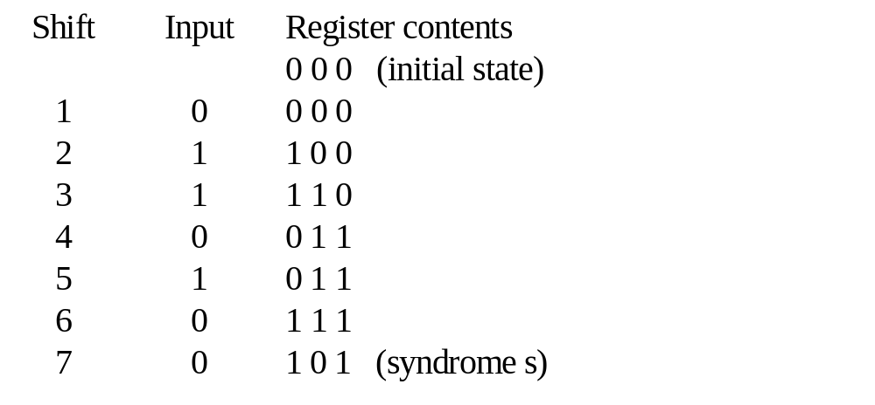

Example: Circuit for Syndrome Computation
Gate
r = 0010110
+
+
What is g(x)?
Find the syndrome using long division.
Find the syndrome using the shortcut for the remainder.
EE 430 \ Dr. Muqaibel
Cyclic Codes <number>

Slide 32
Association of Syndrome to Error Pattern
Look-up table implemented via a combinational logic circuit (CLC). The complexity of the CLC tends to grow exponentially with the code length and the number of errors to correct.
Cyclic property helps in simplifying the decoding circuit.
The circuit is designed to correct the error in a certain location only, say the last location. The received word is shifted cyclically to trap the error, if it exists, in the last location and then correct it. The CLC is simplified since it is only required to yield a single output e telling whether the syndrome, calculated after every cyclic shift of r(X), corresponds to an error at the highest-order position.
The received digits are thus decoded one at a time.
EE 430 \ Dr. Muqaibel
Cyclic Codes <number>

Slide 33
Meggit Decoder
Shift r(X) into the buffer B and the syndrome register R simultaneously. Once r(X) is completely shifted in B, R will contain s(X), the syndrome of r(X).
1. Based on the contents of R, the detection circuit yields the output e (0 or 1).
2. During the next clock cycle:
(a) Add e to the rightmost bit of B while shifting the contents of B. (The rightmost bit of B may be read out). Call the modified content of B r₁⁽¹⁾(X).
EE 430 \ Dr. Muqaibel
Cyclic Codes <number>

Slide 34
Meggit Decoder (cont’d)
(b) Add e to the left of R while shifting the contents of R. The modified content of R is s₁⁽¹⁾(X), the syndrome of r₁⁽¹⁾(X) [will be shown soon].
Repeat steps 1-2 n times.
EE 430 \ Dr. Muqaibel
Cyclic Codes <number>

Slide 35
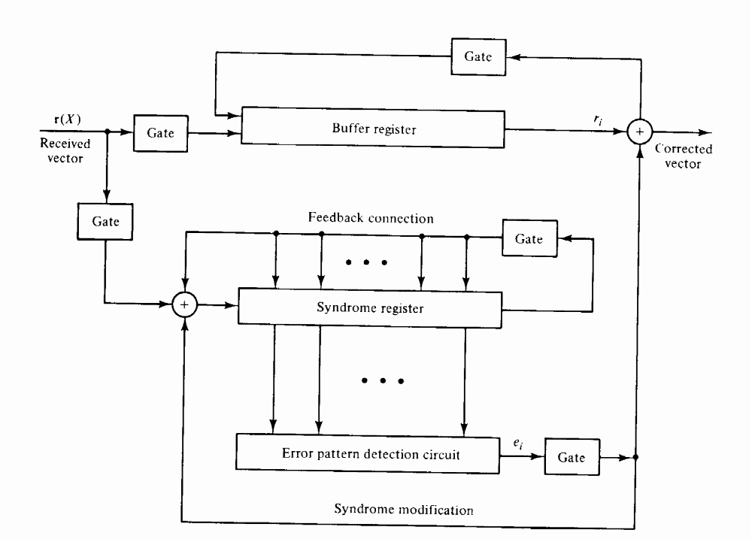
General Decoding Circuit
EE 430 \ Dr. Muqaibel
Cyclic Codes <number>

Slide 36
More on Syndrome Computation
Let s(X) be the syndrome of a received polynomial r(X) = r₀ + r₁X +….+ r_{n-1}X^{n-1} . Then the remainder resulting from dividing Xs(X) by g(X) is the syndrome of r⁽¹⁾(X), which is a cyclic shift of r(X).
Proof: r(X) = r₀ + r₁X +….+ r_{n-1}X^{n-1}
    r⁽¹⁾(X) = r_{n-1} + r₀X +….+ r_{n-2}X^{n-1} = r_{n-1} + Xr(X) + r_{n-1}X^{n}
        = r_{n-1}(X^{n}+1) + Xr(X)
    c(X)g(X) + y(X) = r_{n-1} g(X)h(X)+ X{a(X)g(x) + s(X)}
    where y(X) is the syndrome of r⁽¹⁾(X) .
    Xs(X) = {c(X) + a(X) + r_{n-1} h(X)}g(X) + y(X)
  Therefore, Syndrome of r⁽¹⁾(X)= Rem[Xs(X)/g(X)]. Q.E.D.
EE 430 \ Dr. Muqaibel
Cyclic Codes <number>

Slide 37
More on Syndrome Computation (cont’d)
Note: for simplicity of notation, let Rem[Xs(X)/g(X)] be denoted by s⁽¹⁾(X). s⁽¹⁾(X) is NOT a cyclic shift of s(X), but the syndrome of r⁽¹⁾(X) which is a cyclic shift of r(X).
Example:
r(X) = X² + X⁴ + X⁵; g(X) = 1 + X + X³
s(X) = Rem[r(X)/g(X)] = 1 + X²
r⁽¹⁾(X) = X³ + X⁵ + X⁶
s⁽¹⁾(X) = Rem[r⁽¹⁾(X)/g(X)] = 1 (polynomial)
Also, s⁽¹⁾(X) = Rem[Xs(X)/g(X)] = 1.
EE 430 \ Dr. Muqaibel
Cyclic Codes <number>

Slide 38
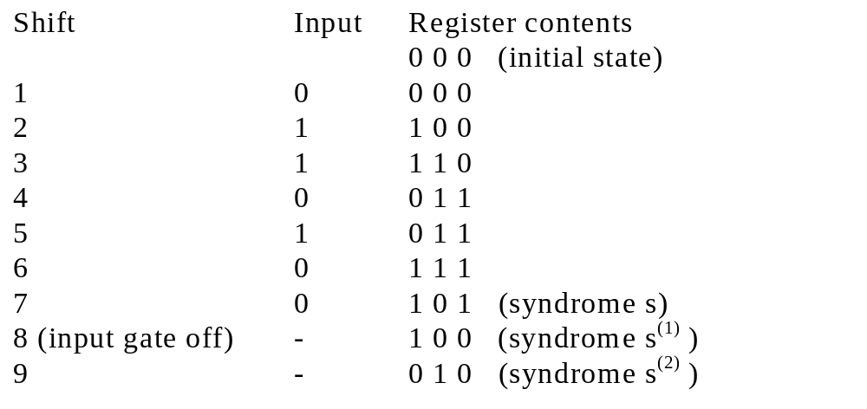
More on Syndrome Computation (cont’d)
Gate
Gate
+
+
r = 0010110
EE 430 \ Dr. Muqaibel
Cyclic Codes <number>

Slide 39
More on Syndrome Computation (cont’d)
Let r(X) = r₀ + r₁X +….+ r_{n-1}X^{n-1} has the syndrome s(X).Then
r⁽¹⁾(X) = r_{n-1} + r₀ X + ….+ r_{n-2}X^{n-1} has the syndrome:
s⁽¹⁾(X) = Rem[r⁽¹⁾(X)/g(X)].
Define r₁ (X) = r(X) + X^{n-1} = r₀ + r₁X +….+ (r_{n-1}+1)X^{n-1}
The syndrome of r₁ (X), call it s₁ (X):
s₁ (X)= Rem[{r(X)+ X^{n-1}}/g(X)] = s(X) + Rem[X^{n-1}/g(X)]
r₁⁽¹⁾(X), which is one cyclic shift of r₁ (X), has the syndrome
s₁⁽¹⁾(X) = Rem[X s₁ (X)/g(X)] = Rem[Xs(X)/g(X)+ X^{n}/g(X)]
= s⁽¹⁾(X) + 1 (since X^{n} +1 = g(X)h(X))
EE 430 \ Dr. Muqaibel
Cyclic Codes <number>

Slide 40
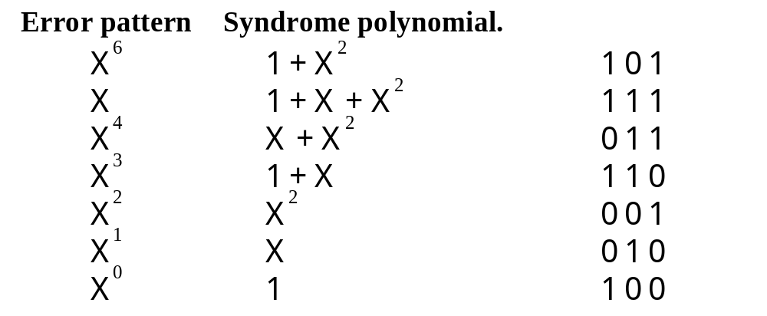
Worked Example
Consider the (7,4) Hamming code generated by 1+X+X³.
Let c = 1 0 0 1 0 1 1 and r = 1 0 1 1 0 1 1
EE 430 \ Dr. Muqaibel
Cyclic Codes <number>

Slide 41
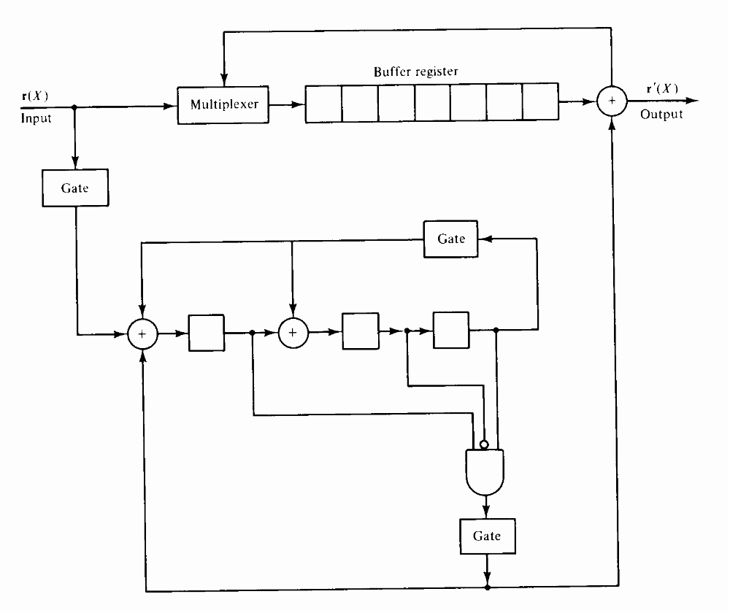
Cyclic Decoding of the (7,4) Code
EE 430 \ Dr. Muqaibel
Cyclic Codes <number>

Slide 42
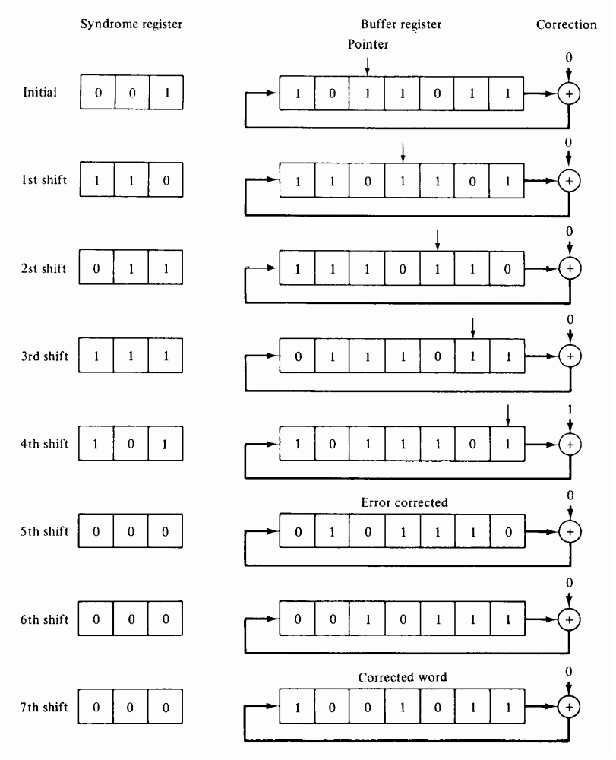
EE 430 \ Dr. Muqaibel
Cyclic Codes <number>

Slide 43
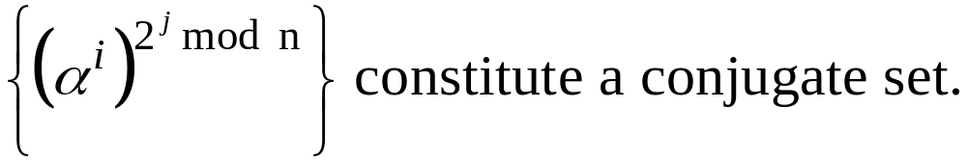
Error Correction Capability
Error correction capability is inferred from the roots of g(X).
Results from Algebra of Finite Fields:
X^{n} +1 has n roots (in an extension field)
These roots can be expressed as powers of one element, α.
The roots are α⁰, α¹ , …., α^{n-1}.
The roots occur in conjugates.
EE 430 \ Dr. Muqaibel
Cyclic Codes <number>

Slide 44
Designing a Cyclic Code
Theorem:
If g(X) has l roots (out of it n-k roots) that are consecutive powers of α, then the code it generates has a minimum distance d = l + 1.
To design a cyclic code with a guaranteed minimum distance of d, form g(X) to have d-1 consecutive roots. The parameter d is called the designed minimum distance of the code.
Since roots occur in conjugates, the actual number of consecutive roots, say l, may be greater than d-1. d_{min} = l + 1 is called the actual minimum distance of the code.
EE 430 \ Dr. Muqaibel
Cyclic Codes <number>

Slide 45
Design Example
X¹⁵ + 1 has the roots 1= α⁰, α¹ , …., α¹⁴.
  Conjugate group Corresponding polynomial
  (α⁰) φ₁(X)=1 + X
  (α, α² , α⁴ , α⁸) φ₂(X)= 1 + X + X⁴
  (α³ , α⁶ , α⁹ , α¹²) φ₃(X)= 1 + X + X² + X³ + X⁴
  (α⁵ , α¹⁰) φ₄(X)= 1 + X + X²
  (α⁷, α¹⁴ , α¹³ , α¹¹) φ₅(X)= 1 + X³ + X⁴
EE 430 \ Dr. Muqaibel
Cyclic Codes <number>

Slide 46
Design Example (cont’d)
Find g(X) that is guaranteed to be a double error correcting code.
  The code must have α, α² , α³ and α⁴ as roots.
  g(X) = φ₂(X) φ₃(X) = 1 + X⁴ + X⁶ + X⁷ + X⁸
  This generator polynomial generates a (15, 7) cyclic code
  of minimum distance at least 5.
  Roots of g(X) = α, α², α³ , α⁴ , α⁶, α⁸ , α⁹ , α¹².
  Number of consecutive roots = 4.
  The actual minimum distance of the code is 5.
EE 430 \ Dr. Muqaibel
Cyclic Codes <number>

Slide 47
Some Standard Cyclic
Block Codes
Cyclic Codes
BCH Codes
Hamming Codes
Linear
Codes
The Hamming Codes: single-error correcting codes which can be expressed in cyclic form.
BCH: the Bose-Chaudhuri-Hocquenghem are among the most important of all cyclic block codes. Extenstion of Hamming for t-error correcting codes.
Some Burst-Correcting Codes: good burst-correcting codes have been found mainly by computer search.
Cyclic Redundancy Check Codes: shortened cyclic error-detecting codes used in automatic repeat request (ARQ) systems.
EE 430 \ Dr. Muqaibel
Cyclic Codes <number>

Slide 48
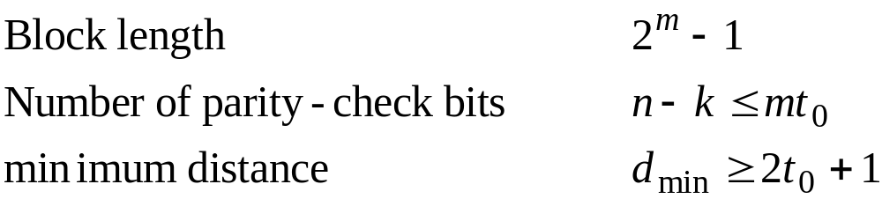
BCH Codes
Definition of the codes:
For any positive integers m (m>2) and t₀ (t₀ < n/2), there is a BCH binary code of length n = 2^{m} - 1 which corrects all combinations of t₀ or fewer errors and has no more than mt₀ parity-check bits.
EE 430 \ Dr. Muqaibel
Cyclic Codes <number>

Slide 49
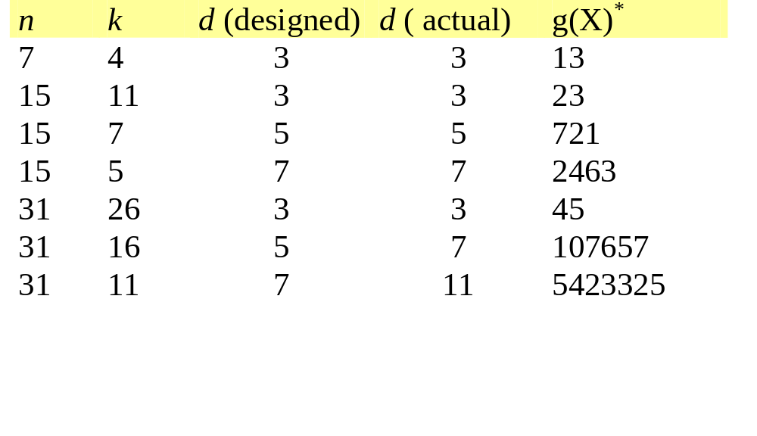
Table of Some BCH Codes
* Octal representation with highest order at the left.
721 is 111 010 001 representing 1+X4+X6+X7+X8
EE 430 \ Dr. Muqaibel
Cyclic Codes <number>

Slide 50
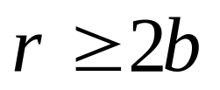
Burst Correcting Codes
good burst-correcting codes have been found mainly by computer search.
The length of an error burst, b, is the total number of bits in error from the first error to the last error, inclusive.
The minimum possible number of parity-check bits required to correct a burst of length b or less is given by the Rieger bound.
The best understood codes for correcting burst errors are cyclic codes.
For correcting longer burst interleaving is used.
EE 430 \ Dr. Muqaibel
Cyclic Codes <number>

Slide 51
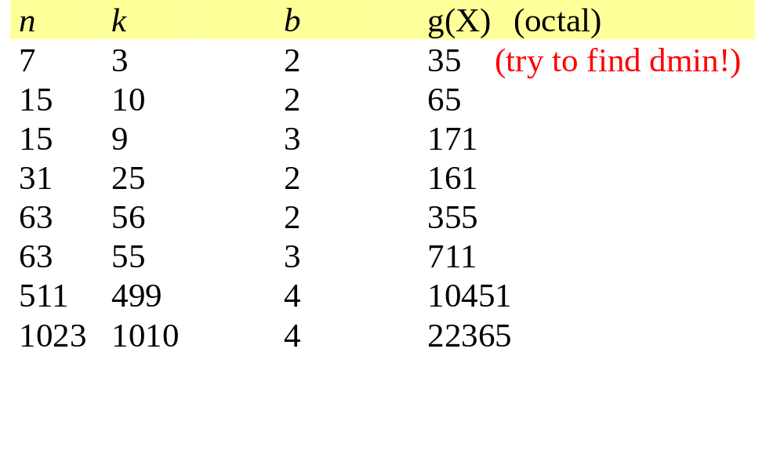
Table of Good Burst-Correcting Codes
EE 430 \ Dr. Muqaibel
Cyclic Codes <number>

Slide 52
Cyclic Redundancy Check Codes
Shortened cyclic codes
Error-detecting codes
used in automatic repeat request (ARQ) systems.
Usually concatenated with error correcting codes
CRC
Encoder
CRC Syndrome Checker
Error Correction Encoder
Error Correction Decoder
To
Transmitter
To
Info Sink
EE 430 \ Dr. Muqaibel
Cyclic Codes <number>

Slide 53
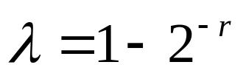
Performance of CRC Codes
CRC are typically evaluated in terms of their
  error pattern coverage
  Burst error detection capability
  Probability of undetected error
For a (n,k) CRC the coverage, λ, is the ratio of the number of invalid blocks of length n to the total number of blocks of length n.
This ratio is a measure of the probability that a randomly chosen block is not a valid code block. By definition,
where r is the number of check bits
For some near-optima CRC codes,
see table 5.6.5
Code | Coverage
CRC-12 | 0.999756
CRC-ANSI | 0.999985
CRC-32A | 0.99999999977
EE 430 \ Dr. Muqaibel
Cyclic Codes <number>

Slide 54
Simple Modifications to Cyclic Codes
Expanding (Extending): increasing the length of the code by adding more parity bits.
  Usually to improve the capability of the code.
  In general, resulting code is not cyclic.
Shortening: decreasing the number of bits in the code.
  To control the total number of bits in a block…To increase the rate of the code.
  In general, resulting code is not cyclic.
Interleaving: improves the burst error-correction capability
  There are many types of interleavers. Consider the Block interleaver/ de-interleaver
EE 430 \ Dr. Muqaibel
Cyclic Codes <number>

Slide 55
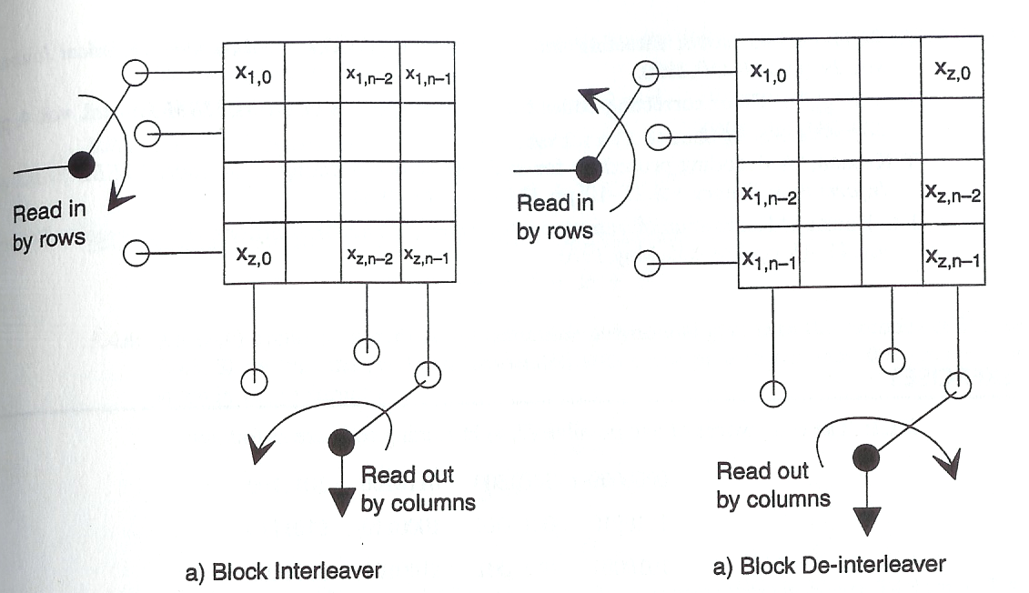
Block Interleaver and De-Interleaver
Try numbers !
EE 430 \ Dr. Muqaibel
Cyclic Codes <number>

